Slide 1
Human Activity Recognition Weekly Report - 2
Han Shen 4.9-4.20

Slide 2
Experiment Goal
Figure out obstacle effect on CSI data
Figure out location variation of CSI data
Figure out CSI variation when other clients connect to same AP

Slide 3
Experiment Platform
Transceiver:
Asus AC-68U Dual Frequency Router (TX)
Mini PC with Intel 5300 NIC(RX)
Third Object(TO): MacBook ping AP at same rate(ping rate: per packet/0.2s) as Mini PC
Parameters
Power: 200mW
Bandwidth: 2.4GHz/20MHZ
Test case
Empty Room with TX, RX in different location, antenna orthogonal or parallel
Room with Obstacle: Travel Case: (metal, cloth, PVC), man/woman stands/crouches, TX-RX in different location
TX-RX-TO at various locations
Data Process
3*3 combination of TX-RX antennas, extract the strongest one(TX=1,RX=1) for comparison.

Slide 4
A
D
H
Experiment
Room
F1
5m
G1
E
G2
Heater
F2
F3
B
C
3m

Slide 5
1. How does CSI amplitude change with different transmitter - receiver locations?
Experiment: Collect CSI data at different TX-RX locations in an empty room

Slide 6
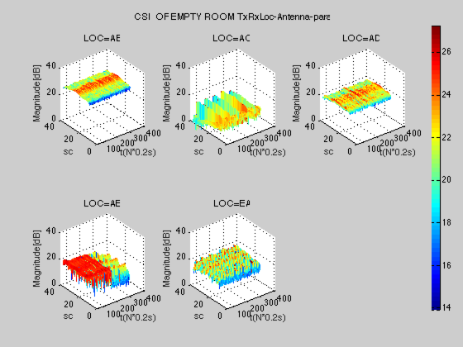
Duration: 50s
Room: Empty
Antenna: Parallel3*3
LOC=Transmitter-
Receiver
A
D
H
F1
G1
E
G2
F2
F3
B
C
Conclusion:
1.CSI amplitude decreases with distance monotonically.
2.CSI amplitude shows smoother surface near wall(AB, AD) than crossing the room(AC, AE, EA),
It might be affected by multipath effect.
3.Abnormal decrease in AE case.

Slide 7
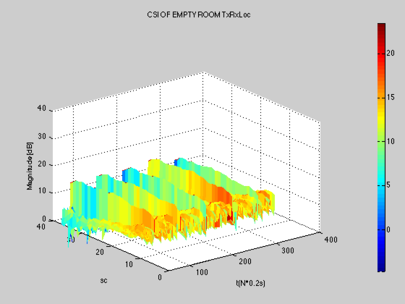
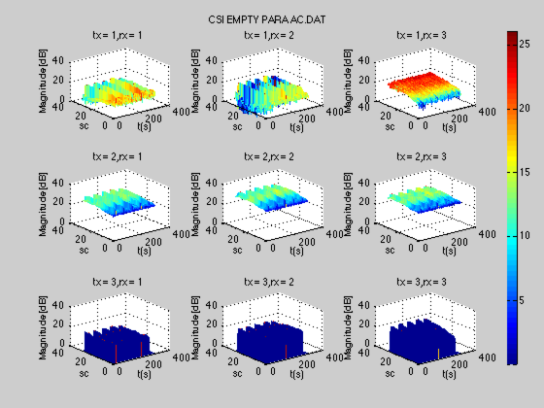
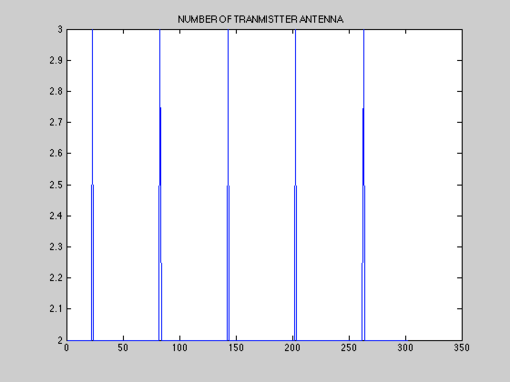
Why does fluctuation occur?
Notice: AP chose 2 antennas instead of original 3 antennas occasionally.
Should it be used as a feature or wiped out? It is an implication of wifi signal strength variation.
Wave peaks match exactly with
TX antenna number’s change!

Slide 8
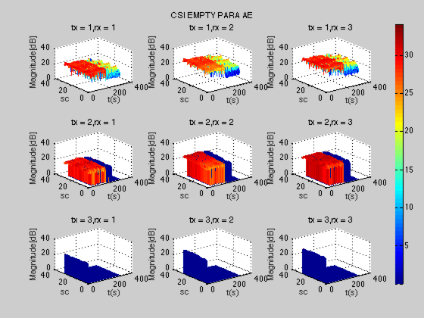
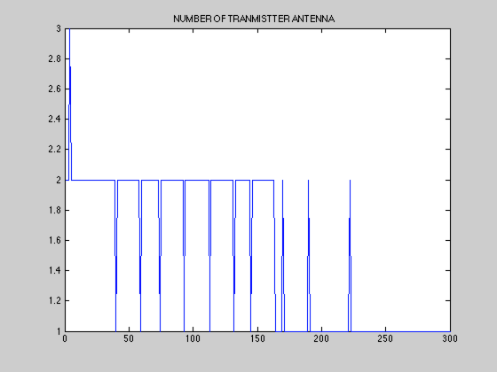
Why abnormal decrease in case AE?
Notice: AP chose 2 antennas instead of original 3 antennas. Might be an experimental bias

Slide 9
2. How does CSI amplitude change with different angle-of-arrival?
Experiment: Collect CSI data at different relative antenna directions(parallel/orthogonal) in same empty room.
[Note]: “Orthogonal” means the line of 3 TX Antennas is orthogonal with line of 3 RX Antennas.

Slide 10
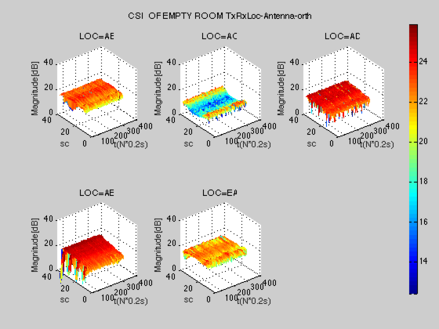
Duration: 50s
Room: Empty
Antenna: orthogonal
3*3
LOC=Transmitter-
Receiver
A
D
H
F1
G1
E
G2
F2
F3
B
C
Conclusion:
1.CSI amplitude decreases when antennas are orthogonal(compared to parallel case ),
especially in AB, AD .
2.CSI amplitude DOESN’T SHOW smoother surface near wall(AB, AD) than crossing the room
(AC, AE, EA)

Slide 11
Why there is no fluctuation in Orthogonal case?
In orthogonal case, CSI amplitude turns out to be lower than in parallel case, but no fluctuation.
Unpredictable antenna adjustment strategy of AP. Be better to set fixed rate instead.

Slide 12
3. How does CSI amplitude change with another client of the dedicated AP?
Experiment: Place a MacBook which pings AP at same rate as the receiver at different locations.

Slide 13
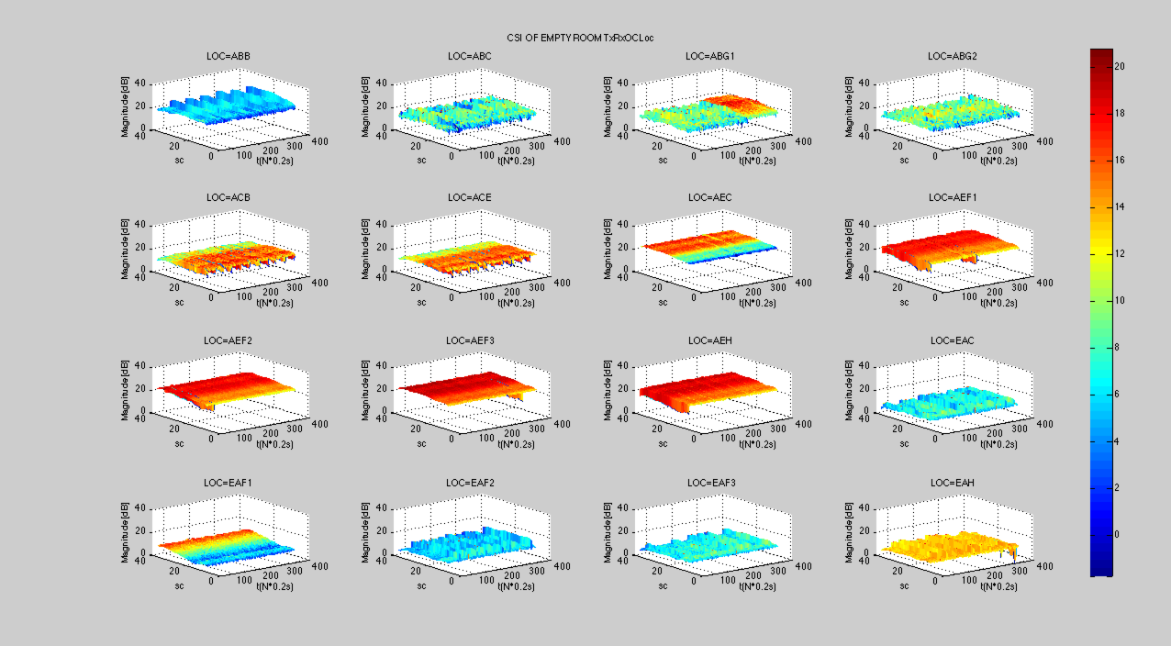
LOC=Transmitter-
Receiver-the Other Client
(OC)
Duration: 35s with OC ping,
followed by 35s OC sleep
Antenna: parallel
3*3
A
D
H
F1
G1
E
G2
F2
F3
B
C
Conclusion:
When sharing same load, OC has no impact on CSI amplitude.
What if OC occupies more than 90% of bandwidth? Next experiment.

Slide 14
4. How does CSI amplitude change with obstacles at different locations?
Experiment: Put a large-size obstacle at multiple locations, collect CSI data in same room.

Slide 15
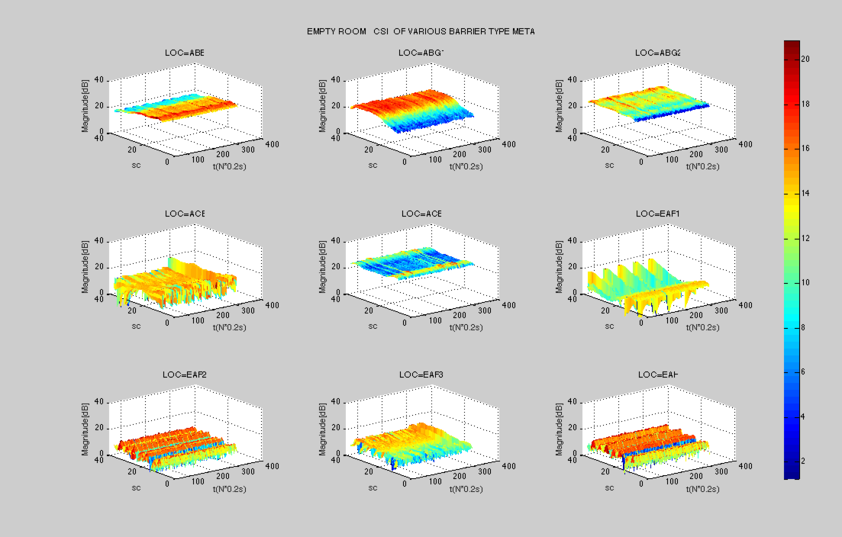
Duration: 50s
Room:
Obstacle, metal box,20’’
Antenna: parallel
3*3
LOC=Transmitter-
Receiver-Obstacle
A
D
H
F1
G1
E
G2
F2
F3
B
C
Conclusion:
1. Obstacle results in significant interference on CSI amplitude.
2. When the transmitter is put in the center of the room while the receiver is put in corner(EA*), CSI amplitude show different degrees of attenuation at certain channels, which could be utilized as an vital feature. (ABG1, EAF2, EAH).
3. Fluctuation with time is caused by the absence of the third TX antenna.

Slide 16
5. How does CSI amplitude change with obstacles of different materials?
Experiment: Put obstacle of materials(metal box, cloth box, plastic box, crouched-man/crouched-woman, standing-man/standing-woman) but roughly similar size at multiple locations, collect CSI data in same room.

Slide 17
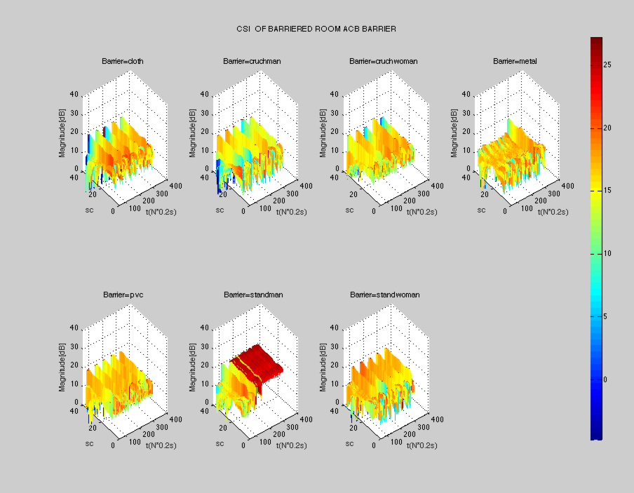
Duration: 50s
Room: Obstacle, 20’’,
material varies
Antenna: parallel
3*3
LOC=ACB
A
D
H
F1
G1
E
G2
F2
F3
B
C
Conclusion:
1. For all obstacles, CSI amplitude shows obvious fluctuations.
2. In this case, obstacle is not on the line of TX-RX, fluctuations of different static materials(cloth, metal, PVC) are similar, while standman shows abnormal CSI magnitude envelope(This might be an individual-dependent case cause the man tested might have moved when he was not supposed to do or that sometimes AP adjusts the transmission sharply by unknown reason------ similar to Q1 case AE ). But from all cases at different locations, human effect differs from static block effect largely.

Slide 18
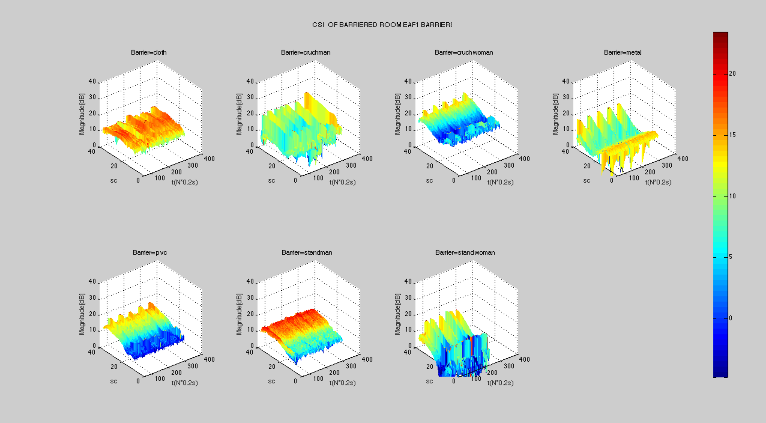
Duration: 50s
Room: Obstacle, 20’’,
material varies
Antenna: parallel
3*3
LOC=EAF1
A
D
H
F1
G1
E
G2
F2
F3
B
C
Conclusion:
When TX-RX is closer(Or when the transmitter is placed in the center of room, which means, rather symmetric), metal material shows sharper fluctuation on CSI.
Man behaves different from women with an abnormal surface. Need more people to be tested to avoid individual bias.

Slide 19
Summary
Experiment on 5 questions.
Significant CSI amplitude fluctuation found in those cases, which also means, it is harder to maintain a fingerprint database since any obstacle joins into the environment could result in large variance for CSI fingerprint at certain location.
Need to fix transmission rate for most of the experiments.
Any research idea?
In a regular living room with different items placed at different place, when items are shifted, moved away, newly brought in, how much effect it brings to wifi localization of a human-being?

